Slide 1
Introduction to Shiny for Scientists
Thomas Bryce Kelly

Slide 2
What is Shiny & where should we start
The Shiny package provides convenient wrapper functions and a ready-to-use platform
Easy to adapt existing R scripts
Goal is to create reactive webpages for data processing
For Today, assume a basic understanding of programming (functions, variables)
An example:
http://tbrycekelly.shinyapps.io/SvenDataAnalysis/

Slide 3
Overview
Architecture
What is it and how does it work?
Examples
What can be done with it?
Deployment
How to make it work for us?

Slide 4
Architecture
What is Shiny and how should I think about it?

Slide 5
Architecture
Server
Webpage
Check boxes
Option 1
Option 2
Option 1
Generate Plot based on input values

Slide 6
Architecture
Server
Webpage
Inputs
&
Outputs

Slide 7
Implementation
library(shiny)
ui = fluidPage(
sliderInput(inputId = "num",
label = "Choose a number",
value = 25, min = 1, max = 100),
plotOutput("hist")
)
server = function(input, output) {
output$hist <- renderPlot({
hist(rnorm(input$num))
})
}
shinyApp(ui = ui, server = server)
Source code of a Shiny app

Slide 8
Implementation
library(shiny)
ui = fluidPage(
sliderInput(inputId = "num",
label = "Choose a number",
value = 25, min = 1, max = 100),
plotOutput("hist")
)
server = function(input, output) {
output$hist <- renderPlot({
hist(rnorm(input$num))
})
}
shinyApp(ui = ui, server = server)
UI
Slider Input
Plot Output
Server
Output Plot
histogram
Random (num)

Slide 9
Flexible IO
Combining just a few input widgets yields a highly functional UI

Slide 10
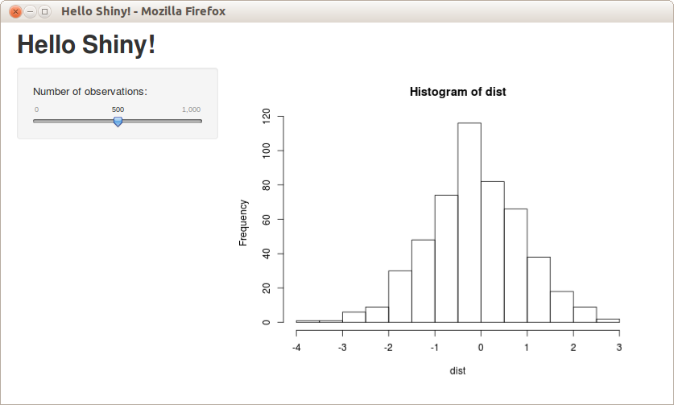
Flexible IO
What you Want... | Simple function to do it
Image | renderImage()
Plot | renderPlot()
Table | renderTable()
Download | renderDownload()
Any | renderUI()
Add plots, text, images, and downloads together with inputs

Slide 11
Examples
What is possible with Shiny?

Slide 12
Examples
Choice?
Shiny
Gallery
Detailed
example

Slide 13
Examples
ui <- fluidPage(title = "Random generator",
tabsetPanel(
tabPanel(title = "Normal data",
plotOutput("norm"),
actionButton("renorm", "Resample")
),
tabPanel(title = "Uniform data",
plotOutput("unif"),
actionButton("reunif", "Resample")
),
tabPanel(title = "Chi Squared data",
plotOutput("chisq"),
actionButton("rechisq", "Resample")
)
)
)
UI
Tab Panel 1
Plot normal
Button
Tab Panel 2
Plot uniform
Button
Tab Panel 3
Plot chi-sq
Button

Slide 14
Examples
server = function(input, output) {
rv = reactiveValues(
norm = rnorm(500),
unif = runif(500),
chisq = rchisq(500, 2))
observeEvent(input$renorm,{ rv$norm = rnorm(500) })
observeEvent(input$reunif,{ rv$unif = runif(500) })
observeEvent(input$rechisq,{ rv$chisq = rchisq(500,2) })
output$norm = renderPlot({
hist(rv$norm)
})
output$unif = renderPlot({
hist(rv$unif)
})
output$chisq = renderPlot({
hist(rv$chisq)
})
}
Server
Variables norm, unif, chisq
Button actions
new random values
Plot normal
histogram of norm
Plot uniform
histogram of uniform
Plot chi-sq
histogram of chi-sq

Slide 15
Deployment
How do I make Shiny work for me?

Slide 16
Deployment (network architecture)
Client
Server
Running R script
Web browser
This is the architecture used when run locally

Slide 17
Deployment (network architecture)
Client
Network Switch
ISP
Server
FSU Network

Slide 18
Deployment (network architecture)
Client
Network Switch
ISP
FSU Network
Server

Slide 19
Deployment
Server | Pros | Cons
ShinyApps.io | Reliability Cloud Based | Limited Free Version ($10/mo for basic)
My server | Cloud Based Control/No limits | Less reliable than commercial product Electric Costs
Lab Computer | Reliability No limits | Local Only Can't share
other | Accessability? | Cost?

Slide 20
Conclusions
Where are we now?

Slide 21
Summary
User Interface
Buttons
Sliders
Upload
Data
Task
Server
Plots
Tables
Download
Results
Reuse

Slide 22
Broader Scope
Best for use in repetative/daily tasks
Can be readily shared with colleagues and collaborators
R can interface with a variety of other languages (Matlab, Java, Python, C++, to name a few)
Not great for development or exploratory analysis
I have another tool for that: Jupyter

Slide 23
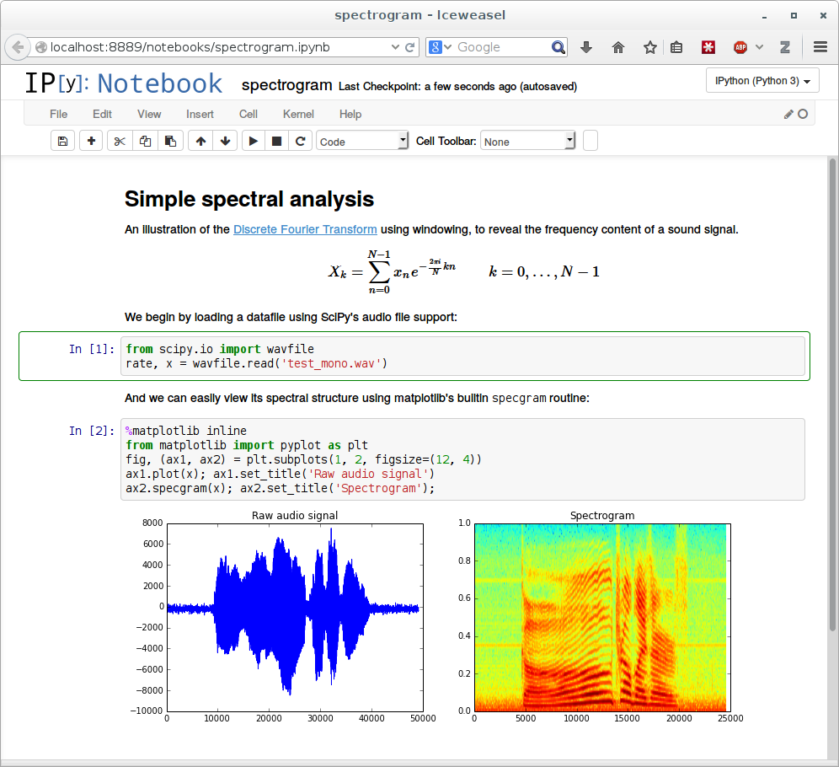
Additional Resources
General Utilities
For Shiny
Jupyter Notebook Project
http://shiny.rstudio.com/tutorial/
http://shinyapps.io/
http://zevross.com/blog/201...
For R
Jupyter Notebook Project
R.matlab package
https://www.r-bloggers.com/

